Slide 1
Advanced Patterns for Automated UI Testing
Seth Petry-Johnson
@spetryjohnson
Notes:
Welcome to “Advanced Patterns for Automated UI Testing”, which I have subtitled “trade offs all the way down”.
Let’s start with the obligatory audience participation survey. Quick show of hands: how many of you are currently writing automated UI tests in your projects? Did anyone used to write them, but gave up?
One thing that I think everyone that raised their hand will agree with is that automated UI tests tend to suck. They require more setup work than other tests. They’re slow to execute, can’t be run in parallel, and can be difficult to debug.

Slide 2

Notes:
And if you don’t do them correctly, they can be extremely brittle. Even a tiny CSS change can break a whole suite of tests. And because these tests take so long to run, triaging and fixing broken tests can be a very frustrating time sink.
So if UI tests are so problematic, why even bother?

Slide 3
UI tests prove stuff works where it matters: in the browser
Notes:
And the answer is that UI tests give us something that no other type of test can. They give us confidence that all of our code will work correctly when a user hits the site in a browser, which is what really matters.
Unit tests tell us that we have classes and methods that return the correct values when used in isolation.
Integration tests tell us that those classes and methods will correctly modify the database, when they are called from the test runner.
But only UI tests go the final mile and confirm that the browser can parse the HTML, build the DOM, and execute the JavaScript so that the user can accomplish the task they came to do.
Unfortunately, that increased confidence comes at a cost, and UI tests do pose a number of challenges that other test types don’t. If you don’t manage those costs properly, then you might have a hard time writing UI tests that deliver the value you need without becoming an expensive or unmanageable mess.

Slide 4

Notes:
And that’s the point of this talk. I run a very small team that has been actively developing a large and very complex web app for the last eight years. Our product is extremely configurable and dynamic and as we’ve added more and more features the effort needed to regression test it has skyrocketed. We estimate that a full, manual regression test of every single nook and cranny of our app would take a single person 7-8 days.
In order to avoid some of those costs, we started experimenting with automated UI tests about four years ago. We’ve learned some valuable lessons about what works and what doesn’t and we’ve identified some things that work fairly well for us. My goal today is to share these lessons with you in the hope that you can avoid some of the pain that we experienced in our journey.

Slide 5
Today's agenda
When to use a UI test – and when not to
How we use the PageObject pattern
Tips for creating/managing test data
How to design UI-testable components
Notes:
In this session you’ll see:
How we decide whether to use a UI test or some other testing strategy
How we use the PageObject pattern to write our UI tests
How we create and manage test data
How we design UIs and components to be UI-testable
What you will NOT see are many slides about WebDriver or Selenium itself. If you don’t already know how to automate the browser with Selenium, that’s fine; you don’t need to know that to get value from this session. I’m going to focus on concepts and patterns and strategies because it doesn’t matter how much of a Selenium master you are; if you don’t approach UI testing with the right strategy, it’s going to hurt and you’re really going to struggle when things start to get complex.

Slide 6
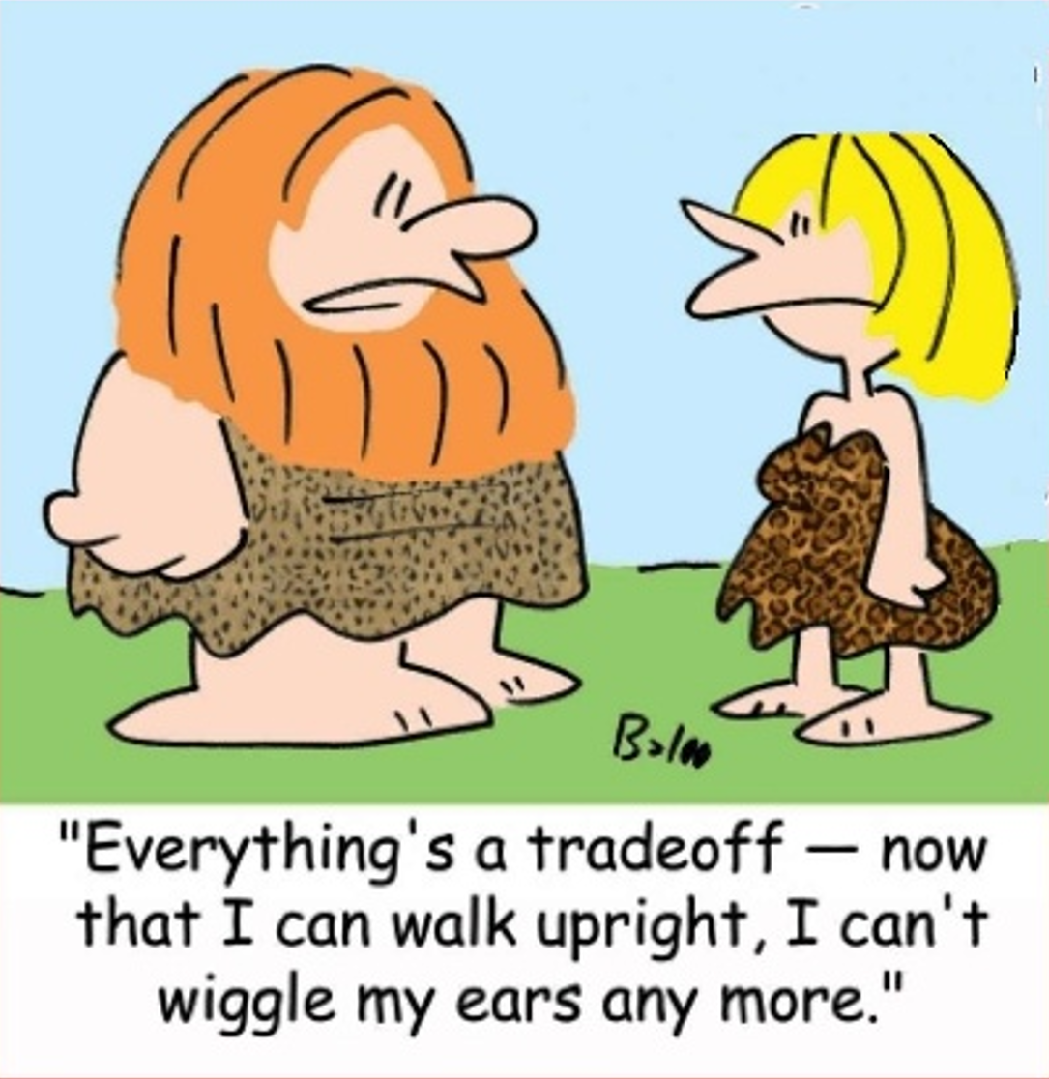
Notes:
I do need to manage expectations here. If you’re hoping to learn the Secret Of The One True Way of UI Testing, you’re going to be disappointed.
This whole talk is a case study in trade-offs. Every decision that my team has made over the last 4 years has consequences, and each decision has informed the decisions that follow it. You might see things in this talk and think “there’s no way that could work for us”. That’s cool. I’m not saying that these patterns are the only things that will work. I’m just saying that these are the techniques that we’ve determined work for us, and I’m hoping that even if you can’t do the exact same thing we do, you can at least learn from our mistakes as you set out to discover your own patterns.

Slide 7
When should we use UI tests?
Only when lower-cost tests won't work instead
Notes:
The first thing I want to talk about is when you should, and should not, write a UI test.
(click to fade in)
The first main point that I want to share today is that you should write UI tests only when a lower-cost test can’t sufficiently prove that the software is working as needed.

Slide 8
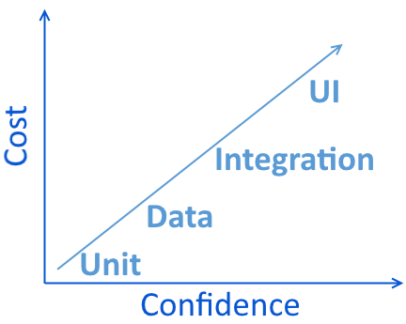
Types of Tests
UI / Functional
Integration
Data
Unit
Notes:
My team differentiates between these 4 types of tests, and each type of test involves a different trade-off between cost and the confidence that it gives us about the system.
Unit tests are generally easy to write and cheap to execute, but they don’t give us a lot of confidence in the overall system. UI tests give us lots of confidence, but they’re hard to write and costly to execute. And there are varying degrees of trade-offs in the middle.
Our strategy is to cover as much as we can with the cheaper, low-level tests and then write higher level tests that close specific gaps.
What does that mean? Let’s take it level by level.

Slide 9
Types of Tests
Use unit tests for…
Validating computations
Testing interactions between components (using mocks)
TDD
UI / Functional
Integration
Data
Unit
Notes:
The lowest level test we write are unit tests that focus on a single, tiny piece of functionality at a time. All dependencies, including the database, are mocked out so that we can completely isolate the code being tested. We use these to test computations and calculations, and when we want to use mock objects to do interaction-based testing.
Whenever possible, we prefer to exhaustively test our business logic with unit tests.

Slide 10

Types of Tests
UI / Functional
Integration
Data
Unit
Notes:
The problem is that unit tests only tell us that we have tiny bits of code that work correctly in isolation. That’s it; they don’t give us any confidence whatsoever that those individual units will work correctly as an integrated system. These tests could be green even if the database doesn’t exist yet!
One way to increase the level of confidence we get from the test suite is to hit an actual database. Some teams call any test that hits a database an “integration” test but I think it’s helpful to differentiate between “data tests” and “integration tests”.

Slide 11
Types of Tests
UI / Functional
Integration
Data
Unit
Notes:
In our nomenclature, a “data test” is basically a unit test of the data access layer itself. These tests target very small units of code, they just happen to involve a real database. We still don’t know if the application as a whole will correctly integrate those tiny units, but at least know the queries they would generate are correct, and that helps move the confidence needle a bit. On the other hand, they cost more as well because we have to set up real data to run them, and because hitting a real database makes them slower to execute.

Slide 12
Types of Tests
Use data tests for…
UI / Functional
Integration
Data
Unit
Validating computations performed in the database
Verifying that queries return/modify the correct data
TDD (of the data layer)
Notes:
Data tests are ideal for testing stuff that happens in the database, and that’s about it. We use these to validate calculations that can’t be unit tested, and if we’re doing TDD on a data access component.

Slide 13
Types of Tests
MVC Controller
View Model
Service Class
Data Component
Integration test (no mocks)
Data test
UI / Functional
Integration
Data
Unit
Notes:
To get even more confidence in the system, however, we have to start testing those units in concert with each other and not in isolation. That’s where integration tests come in.
In practical terms, data tests and integration tests are very similar; both call some piece of code directly in order to test it, and both use a real database without any mock objects.
The main difference is that a data test typically calls some low-level method in the data access layer that usually does not call into any additional components. An integration test typically calls some higher-level method in the application code that does have other dependencies.

Slide 14
Types of Tests
UI / Functional
Integration
Data
Unit
Notes:
By calling into code at a higher level in the stack, integration tests more closely simulate what actually happens in production, and green integration tests give us even more confidence in the system.
However, integration tests are often more costly to write because they require additional setup work than unit or data tests. For example, when you test a data access method you just need to worry about setting up the database. But if you write an integration test against a controller action method, you might need to set up the database and create a user object to be the logged in user and some session state object.

Slide 15
Types of Tests
Use integration tests for…
UI / Functional
Integration
Data
Unit
Validating business logic involving multiple components, but doesn't involve the UI
Validate that unit-tested logic works “for reals”
Notes:
We primarily use integration tests when there are business rules that involve multiple components, and when we don’t really care about the UI. For example, we have tons of code that handles form posts and does all kinds of data validation and business processing. That code can be validated by examining the changes that are made, or not made, to the database, so we can achieve the desired level of confidence without involving the UI.
We could and do write unit tests for much of this logic, but we’ve found that with a complex system there are tons of things that can go wrong at runtime that a unit test with mocks will never identify. So even when components are unit tested, we layer in some integration tests to give us the extra degree of confidence.

Slide 16
Types of Tests
UI / Functional
Integration
Data
Unit
Notes:
UI tests finish out the trend line. These are the most costly tests we write because they require the most effort to set up and are the slowest to execute, but they also give us the most confidence in the system. We focus our UI tests things that cannot be tested any other way. And if you think about it, there are lots of things that are difficult to test without standing up the full web stack, hitting it with a browser, parsing the HTML, and executing the JavaScript.

Slide 17
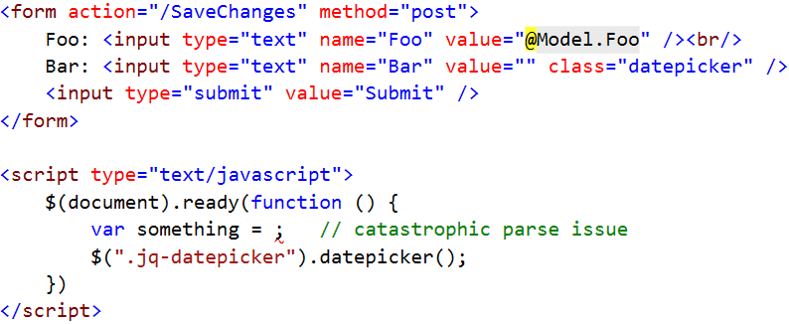
Types of Tests
UI / Functional
Integration
Data
Unit
Notes:
Let’s say you have a simple Edit page. Someone clicks on a link and hits an endpoint and the system returns an HTML form. The person makes changes to the form and clicks submit, and then the form gets POSTed to another endpoint where the form data is processed in some way. Think about all of the things that could go wrong:

Slide 18
Types of Tests
UI / Functional
Integration
Data
Unit
Notes:
Maybe the code that renders the form doesn’t initialize its default values to match the thing being edited, so the form renders but the fields are blank.

Slide 19
Types of Tests
UI / Functional
Integration
Data
Unit
Notes:
Maybe the form uses a jQuery plugin for one of the fields, but there’s a syntax error in some JavaScript and it causes the JS engine to abort before the plugin is fully initialized.

Slide 20
Types of Tests
UI / Functional
Integration
Data
Unit
Notes:
Or maybe someone changed a CSS class on a field, but didn’t update the JS to match so the plugin doesn’t actually do anything.

Slide 21
Types of Tests
UI / Functional
Integration
Data
Unit
Notes:
Or maybe the <form> tag has a typo in the action element and points to an invalid location, or maybe the endpoint it posts to has been renamed but the form wasn’t updated

Slide 22
Types of Tests
UI / Functional
Integration
Data
Unit
Notes:
Or maybe the field names on the form don’t match up with the payload the endpoint is expecting, so even though the user’s changes are sent to the server, they end up getting ignored.

Slide 23
Types of Tests
Use UI tests for…
UI / Functional
Integration
Data
Unit
Validating that all UI elements work together
Testing user interaction rather than business rules
Notes:
These sorts of things are impossible to catch with a compiler or code-level test, so that’s what we focus UI tests on.
We rarely, if ever, write UI tests to validate back-end business rules; it’s all about ensuring that the browser can parse the HTML, build the DOM, execute the JS, and respond correctly to the user’s input.

Slide 24
Types of Tests
UI
Integration
Data
Unit
UI / Functional
Integration
Data
Unit
Notes:
You may have seen the Testing Pyramid before, which tells you to create a lot of unit tests, fewer integration tests, and even fewer UI tests.
I don’t like thinking of it as a pyramid though because the pyramid suggests that there is a “proper” proportion of one type of test to another, and that type of thinking hasn’t been useful to us.

Slide 25
Types of Tests
Unit
Data
UI / Functional
Integration
Data
Unit
UI
Integration
Notes:
Instead, I like to think of tests as intentionally designed jigsaw pieces that work together as a whole, with limited overlap, and where each type of test fills in the specific gaps created by other types of tests.
The actual proportion of each type of test could change from system to system and feature to feature, and as long as you’re using each type of test for the right type of thing, there’s no right or wrong number of UI tests.

Slide 26
Setting up a UI test
Initial State
Initial Navigation
Assert()
Who's Logged In?
Notes:
Once you’ve decided that you have something worth testing via the UI, you need to write the actual test. Every UI test needs to consider 4 things:
What baseline data needs to exist before the test can run?
What user identity will be used to perform the test? [TODO]
How does the test navigate to the “starting page” or context from which the test begins?
Once the browser is on the target page, how do we write good, clean, maintainable test code?

Slide 27
Setting up a UI test
Initial State
Initial Navigation
Assert()
Who's Logged In?
Notes:
There are interesting things to consider, and problems to solve, hidden within each of those concerns. I think the best way to talk about these is in reverse, starting with the test code itself.

Slide 28
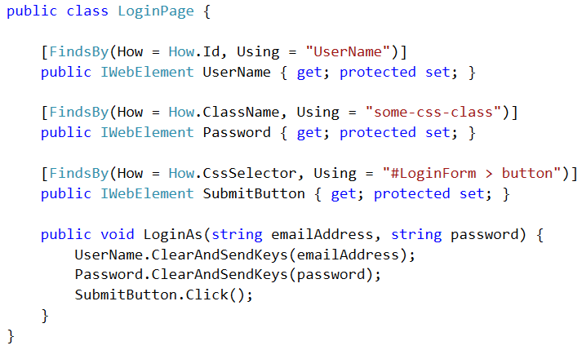
PageObject
Notes:
Like many teams doing UI testing, we organize our tests using the Page Object pattern. This pattern has us create a PageObject class for every page that we want to test, and the job of that PageObject is to provide an API that allows the test code to interact with that page.
This is an example of a PageObject for a Login page.

Slide 29
PageObject
Notes:
The first thing that a PageObject does is expose public properties representing the HTML elements on that page. For instance, a Login form would obviously contain fields for entering a username and password and a button to submit the form.

Slide 30
PageObject
Notes:
We use Selenium WebDriver which gives us this handy FindsBy attribute which allows us to declaratively map each element to the DOM. There are many different lookup strategies you can use, although the vast majority of our use cases are handled with ID and class names. We’ll talk more about that later.

Slide 31
PageObject
Notes:
PageObjects also provide public methods that represent the “services” that a page offers. Since the whole point of a login form is to allow someone to log in, the Login page object might contain a “LoginAs” method that accepts the username or email address and password and then automates the tasks of assigning those values to the HTML elements and submitting the form.

Slide 32
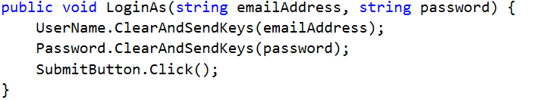
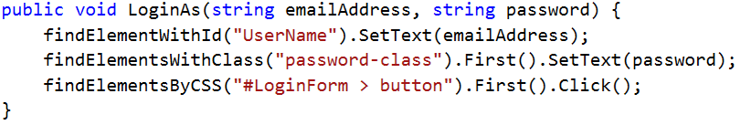
PageObject
Notes:
The key point here is that a good PageObject gives you an application-centric API for writing tests, rather than an HTML-centric one. They should allow a software client, like a test, to do anything that a human being could do, but without requiring that client to know anything about the specific HTML structure in use.
This not only makes the tests easier to read and understand, but it promotes reuse and reduces duplication. If the HTML structure changes over time, you only need to update the affected PageObjects and not every single test that works with those elements.
Even though this is called the “PageObject” pattern, it doesn’t have to be used at the page level. You can create a PageObject for any significant element on a page. For example, we have a feature in our site that lets people configure a certain type of business rule. This feature is implemented within a modal popup and is available from lots of different pages in the site. Even though this isn’t a full “page”, we still encapsulate the functionality exposed by that modal into its own PageObject so that we can easily reuse it in multiple contexts.
You can apply this pattern for a single page application as well. In a single page app you still have separate contexts or views that the page can be in, so you could create a PageObject for each of those contexts.
PageObject is a great high-level pattern to follow, but out of the box it doesn’t necessarily encourage you to write super clean tests. We’ve come up with a couple of micro-patterns that we layer on top of PageObject that really help.

Slide 33
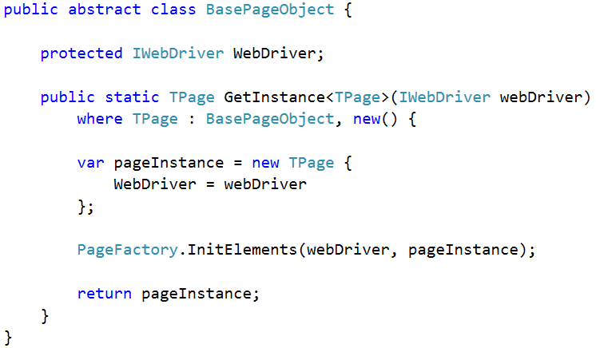
PageObject
Notes:
Target: 21 minutes in

Slide 34
PageObject

Slide 35
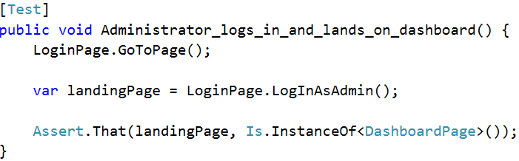
PageObject

Slide 36
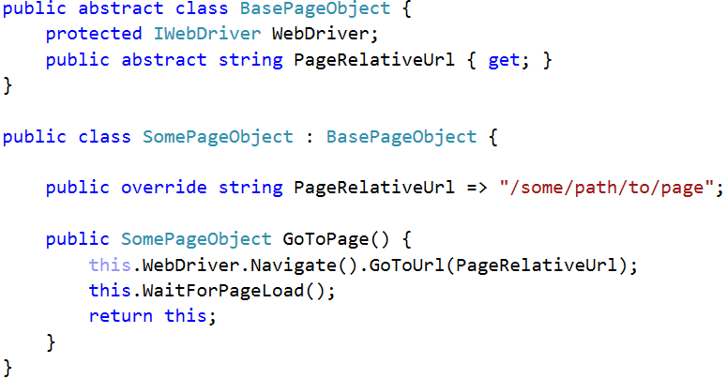
PageObject

Slide 37
PageObject
Notes:
Todo: "why not in base"?

Slide 38
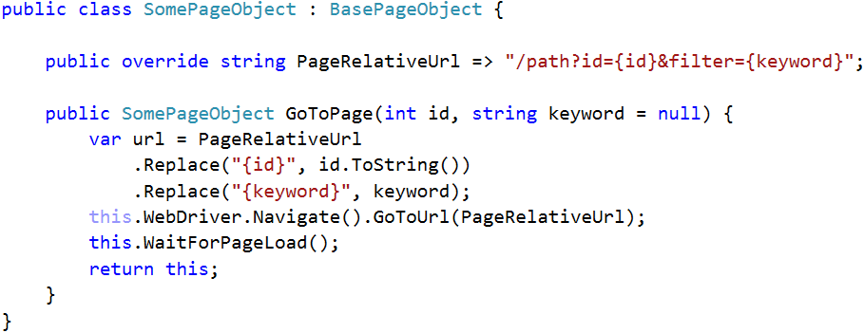
PageObject
Notes:
TODO: add click to show note "Every test begins with a GoTo!"

Slide 39
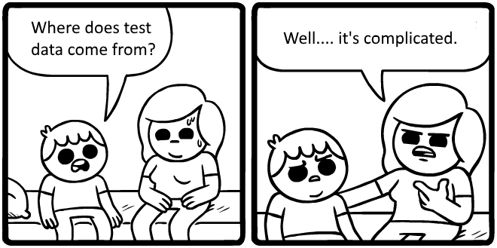

Slide 40
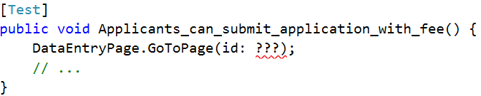
Pre-existing test data
Notes:
TODO: scribble "what goes here?"

Slide 41
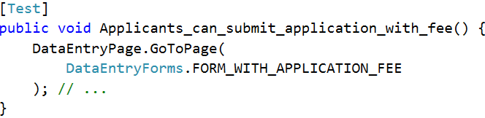
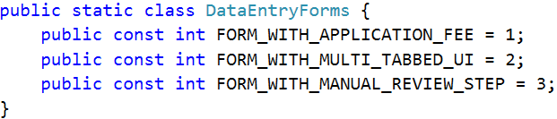
Pre-existing test data

Slide 42
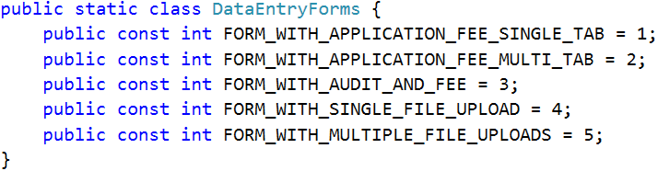
Pre-existing test data

Slide 43
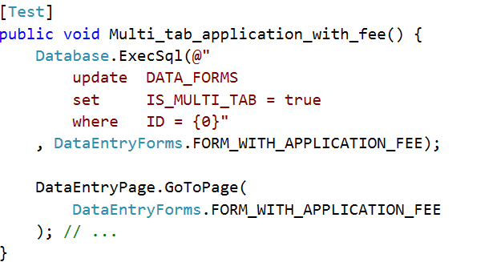
Pre-existing test data

Slide 44
Pre-existing test data

Slide 45
4 rules for using pre-existing test data
Only for UI tests

Slide 46
4 rules for using pre-existing test data
Only for UI tests
Only for data that's difficult to create per-test

Slide 47
4 rules for using pre-existing test data
Only for UI tests
Only for data that's difficult to create per-test
Only rely on loosely-defined data

Slide 48
4 rules for using pre-existing test data
Only for UI tests
Only for data that's difficult to create per-test
Only rely on loosely-defined data
No destructive operations
Notes:
TODO: Add header

Slide 49
4 rules for using pre-existing test data
Only for UI tests
Only for data that's difficult to create per-test
Only rely on loosely-defined data
No destructive operations
Notes:
TODO: Add header

Slide 50
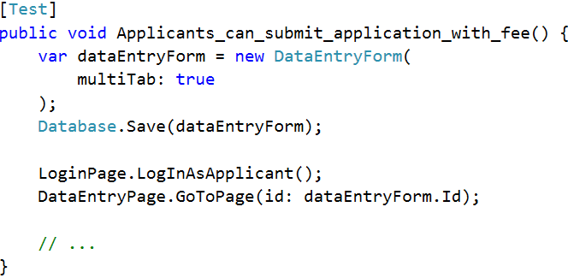
Creating test-specific data

Slide 51
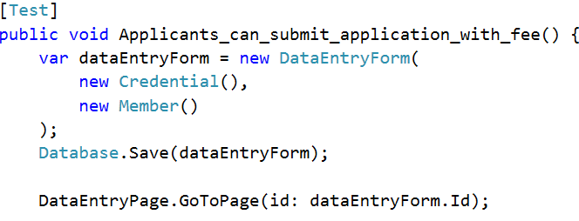
Creating test-specific data

Slide 52
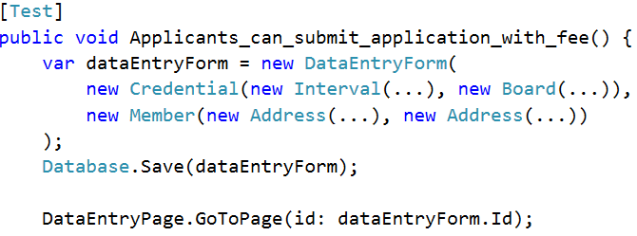
Creating test-specific data

Slide 53
Creating test-specific data

Slide 54
Creating test-specific data
Notes:
TODO: Pointer to "complexity"

Slide 55
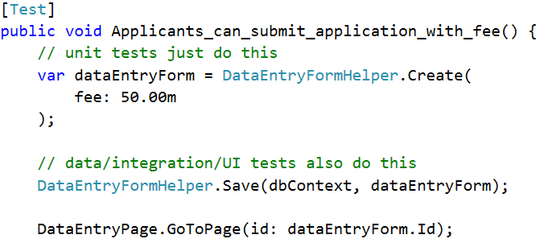
Creating test-specific data

Slide 56
Creating test-specific data

Slide 57
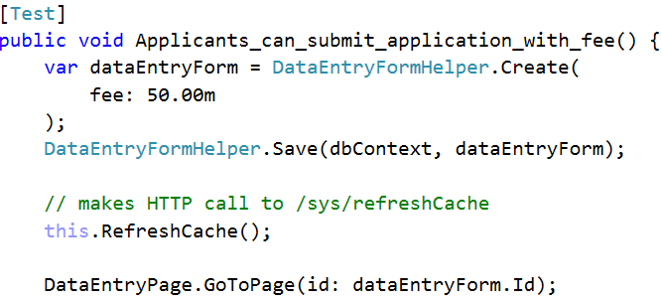
Creating test-specific data

Slide 58
Pre-existing
Tests easier to write / harder to maintain
Managing the database is a PITA
Created per-test
Tests harder to write / easier to maintain
Painful when tests need to change data
Each test run creates more data
Helpers & automation are a must!
Notes:
TODO: Call attention to "created per test"

Slide 59
Do not use side effects of one test as the starting point for another!

Slide 60
Test Data anti-pattern
Submit "New Widget" form
Load & Submit "Edit Widget" form
Submit "Delete Widget" form

Slide 61
Test Data anti-pattern
Submit "New Widget" form
Load & Submit "Edit Widget" form
Submit "Delete Widget" form
Use Widget in App

Slide 62


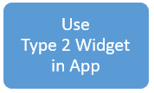
Test Data anti-pattern
Submit "New Widget" form
Load & Submit "Edit Widget" form
Submit "Delete Widget" form
Use Type 1 Widget in App

Slide 63
Test Data anti-pattern
Submit "New Widget" form
Load & Submit "Edit Widget" form
Submit "Delete Widget" form
Use Type 1 Widget in App
Notes:
TODO: issue 1

Slide 64
Test Data anti-pattern
Submit "New Widget" form
Load & Submit "Edit Widget" form
Submit "Delete Widget" form
Use Type 1 Widget in App
Notes:
TODO: issue 1

Slide 65
Test Data anti-pattern
Submit "New Widget" form
Load & Submit "Edit Widget" form
Submit "Delete Widget" form
Use Type 1 Widget in App
Notes:
TODO: issue 1

Slide 66
Writing UI-testable code Unit-testing a view model is better than UI-testing the DOM

Slide 67
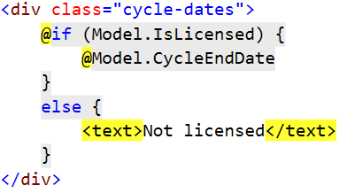
Refactor UI code to make it unit-testable

Slide 68
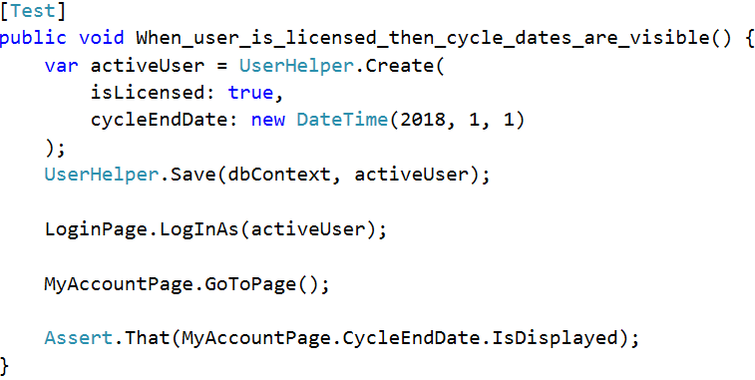
Refactor UI code to make it unit-testable

Slide 69
Refactor UI code to make it unit-testable
Notes:
TODO: Add "not"

Slide 70
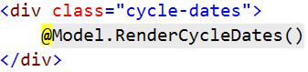
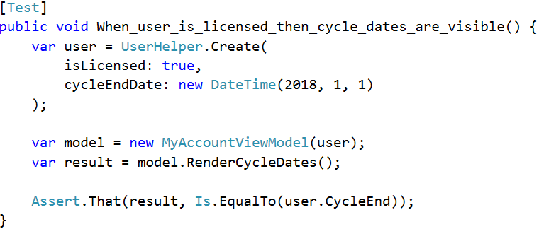
Refactor UI code to make it unit-testable

Slide 71
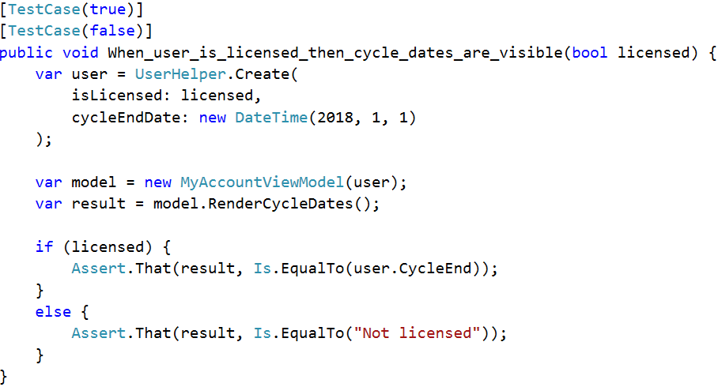
Refactor UI code to make it unit-testable
Notes:
Add note "don't do this…"

Slide 72
Writing UI-testable code Test-specific CSS classes and IDs are better than tight coupling to a rigid HTML structure

Slide 73
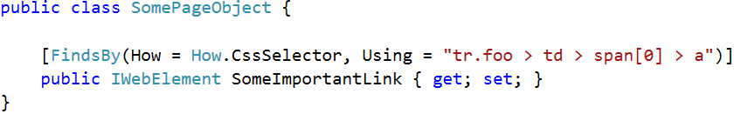
Use UI-test-specific CSS classes & IDs

Slide 74
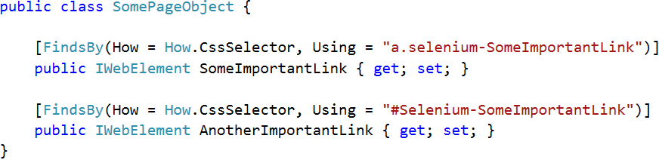
Use UI-test-specific CSS classes & IDs

Slide 75
Writing UI-testable code Test harnesses FTW

Slide 76
Components + Test Harnesses = WIN
Html.YourComponent(…)
$("#something").yourComponent({…})
Vue.component("yourComponent", {…})

Slide 77
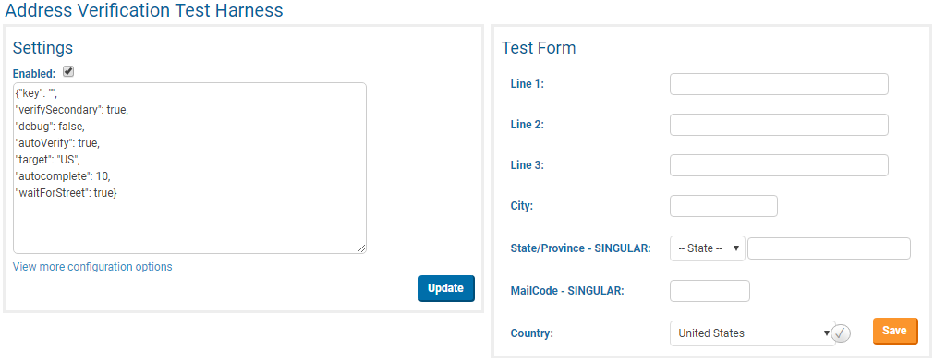
Components + Test Harnesses = WIN

Slide 78
Components + Test Harnesses = WIN
At least 1 test covers the in-app happy path
All other "if <condition> then <outcome>" tests use the harness

Slide 79
Takeaway #1 Have a deliberate test strategy; use UI tests to plug specific gaps left by lower-level tests

Slide 80
Takeaway #2 Dealing with test data sucks; use data creation helpers & automation make it better

Slide 81
Takeaway #3 Create test harnesses, then automate them

Slide 82
Happy Testing!
Have a deliberate test strategy – only UI test what you can't unit test instead.
Tests create their own data using helpers – use automation to clean up.
Test harnesses are awesome. Use them.
@spetryjohnson / seth@petry-johnson.com

